Slide 1
AI Study Buddy
Team Project - MSc Computer Science
Anika Mayesha – D24125187 (Team Leader)
Lorenzo Palleschi – D24126922
Rumaysa Babulkhair – D24125711
Yurii Sykal – C23512523

Slide 2
Brief Weekly overview
Figma redesign 1.2
Competition (Document collaborator)
Technical Architecture
Live code
AI Progress

Slide 3
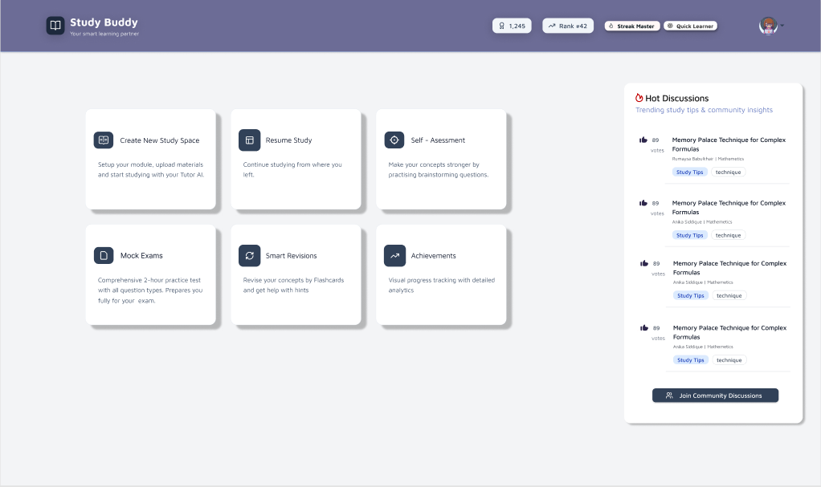
1.1 Figma Design

Slide 4
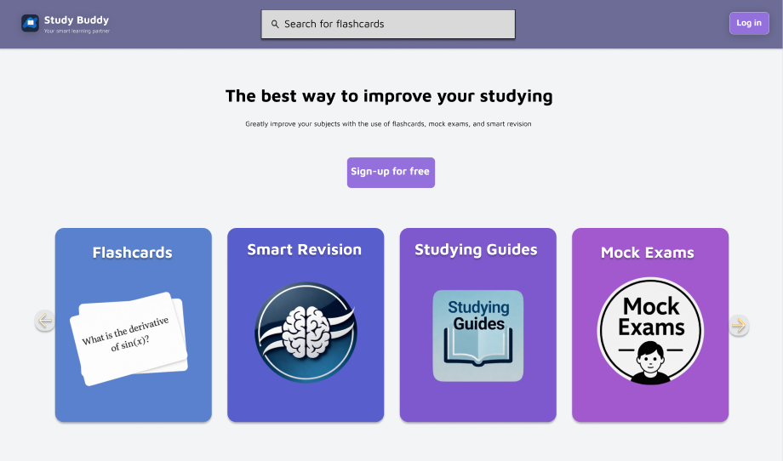
1.2 Figma Design (Logged out)

Slide 5
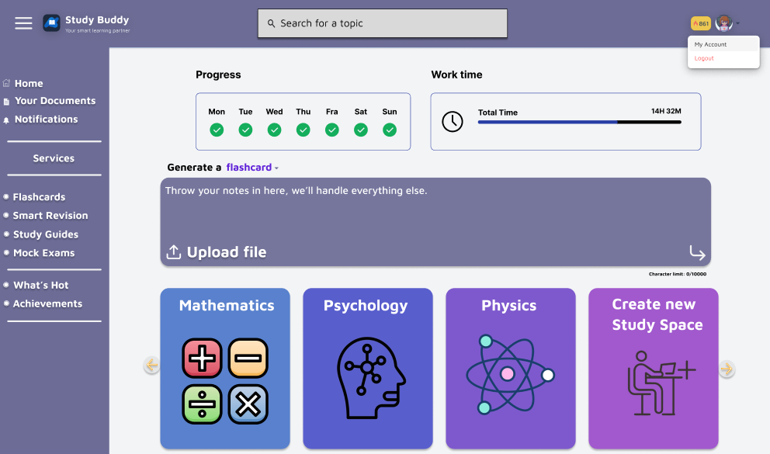
1.2 Figma Design (Logged in)

Slide 6
Thank You
Any Questions?

